Slide 1
Lecture 4 – Logistic Regression for Classification

Slide 2
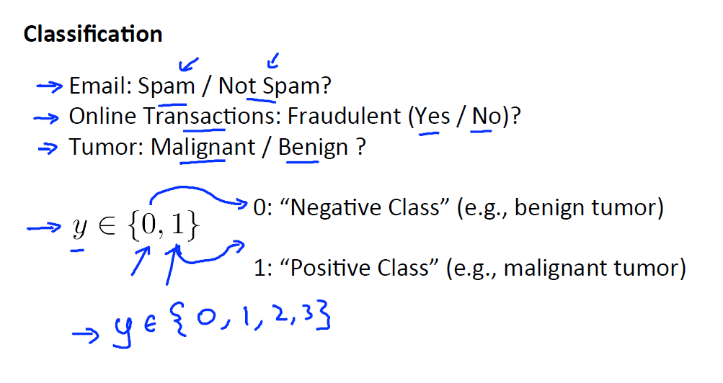
TO DO: Why not linear regression?

Slide 3
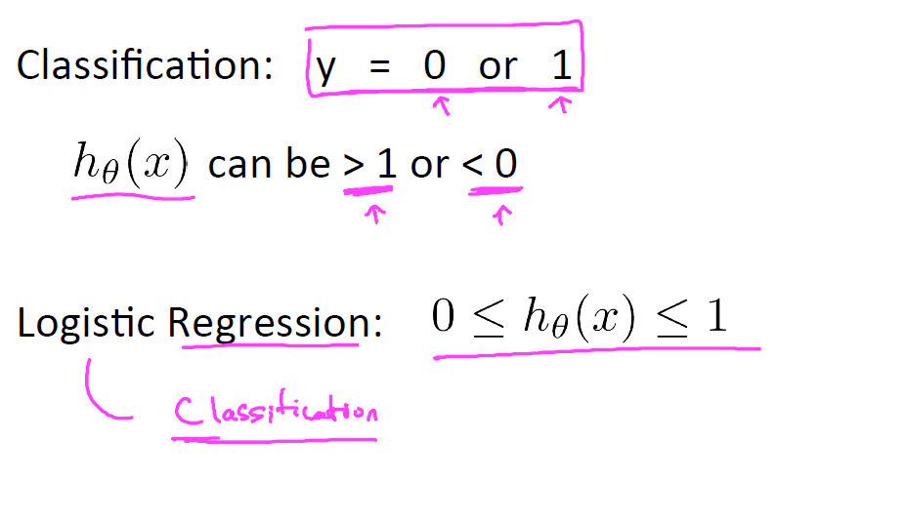

Slide 4
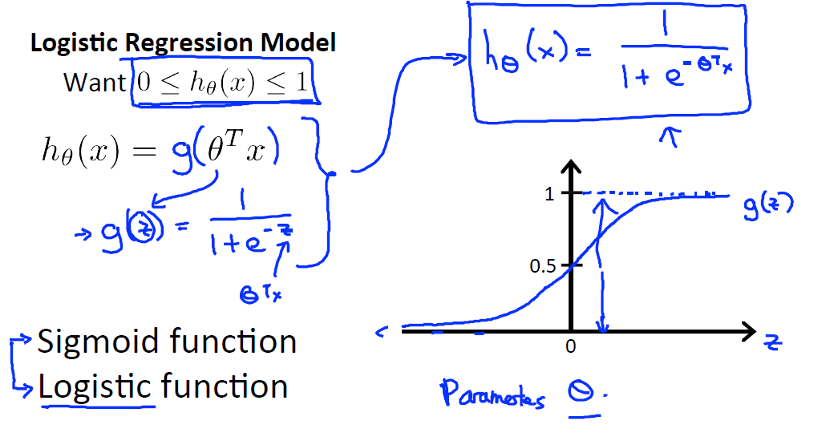

Slide 5
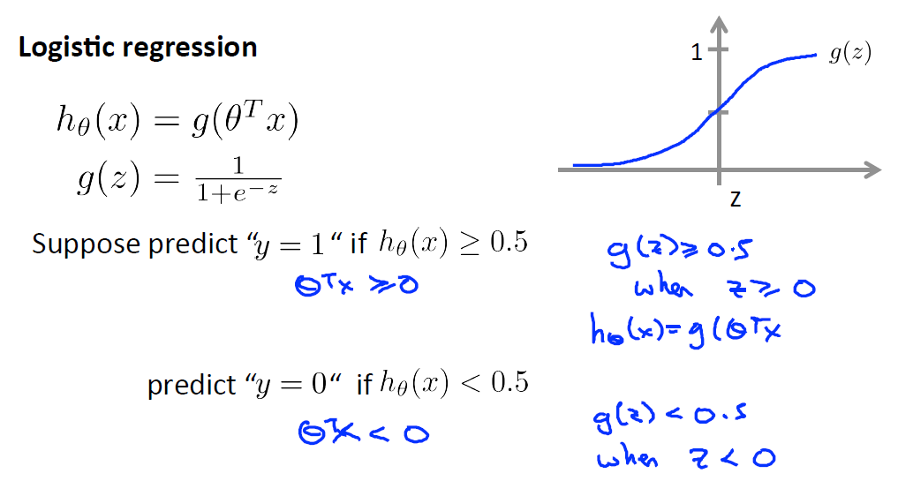
TO DO: Probabilistic interpretation

Slide 6
TO DO: Decision boundary

Slide 7
TO DO: Non linear Decision boundary

Slide 8
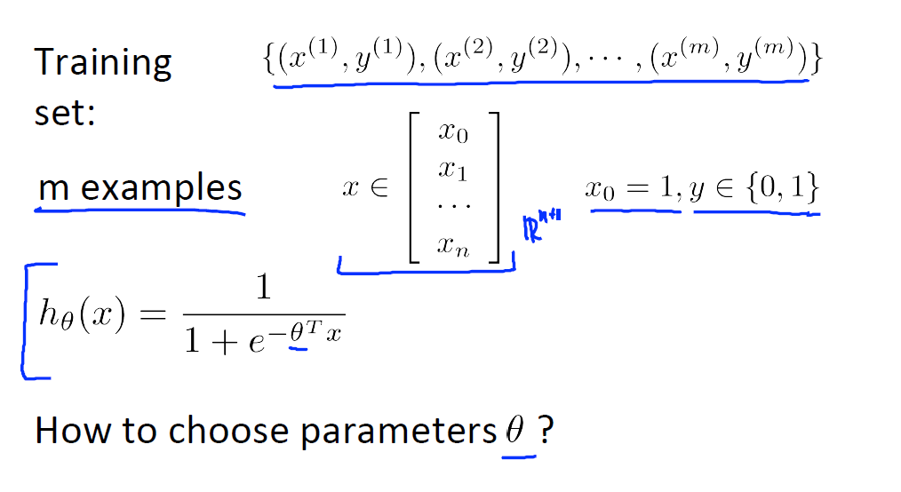

Slide 9
TO DO: Cost function

Slide 10
TO DO: Logistic regression cost function

Slide 11
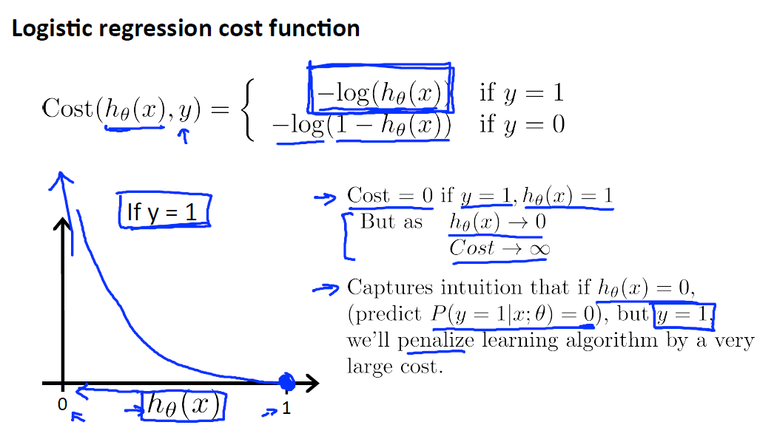

Slide 12
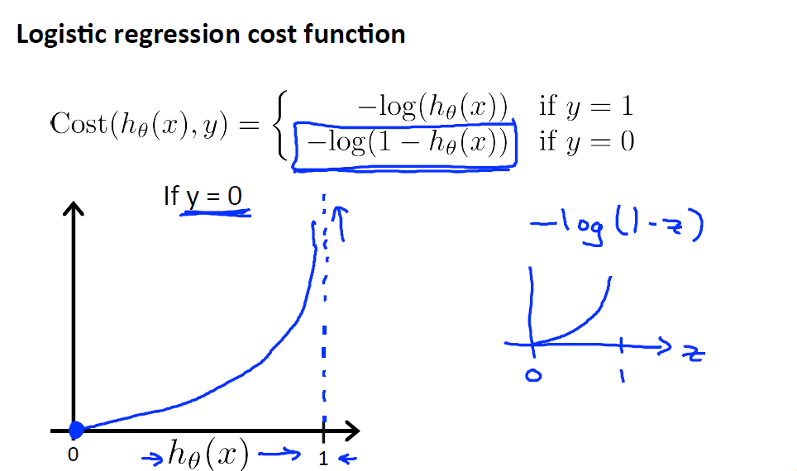

Slide 13
TO DO: Simplified cost function

Slide 14
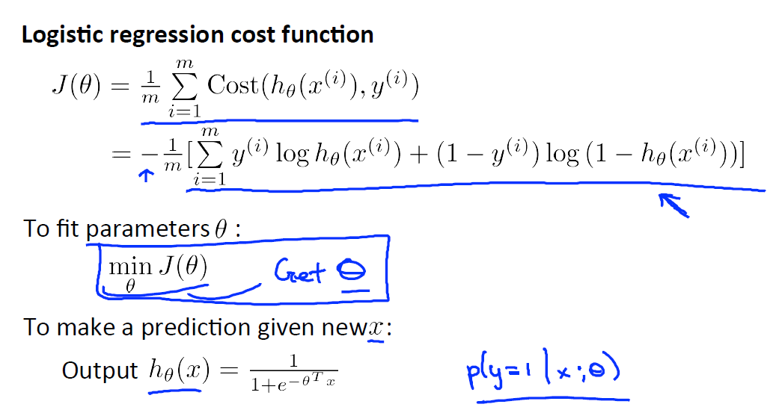

Slide 15
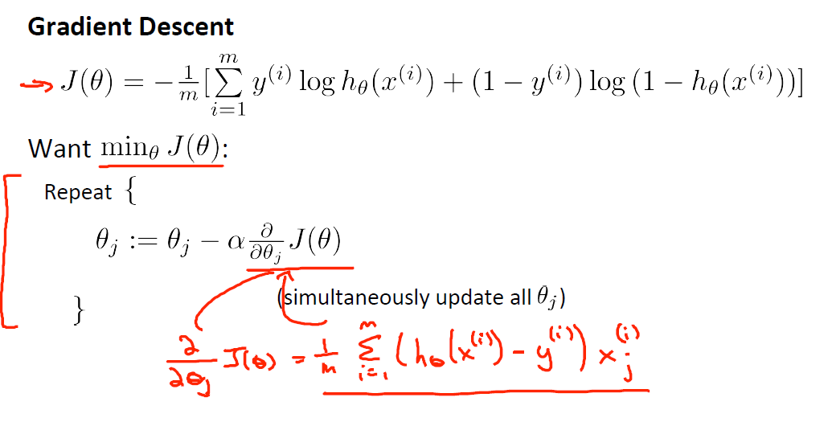

Slide 16
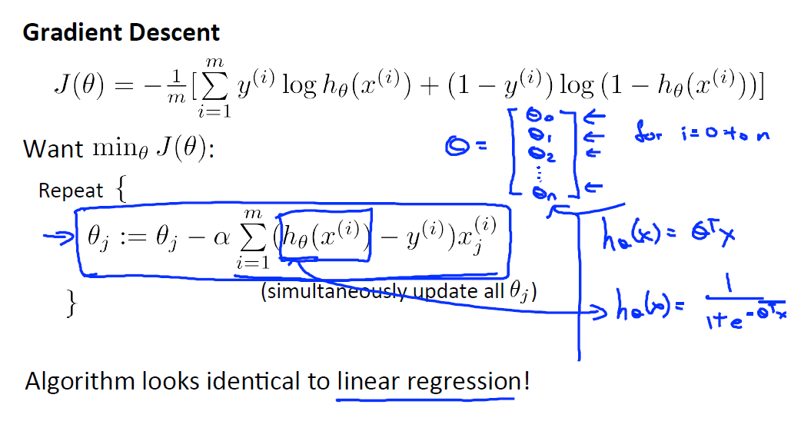

Slide 17
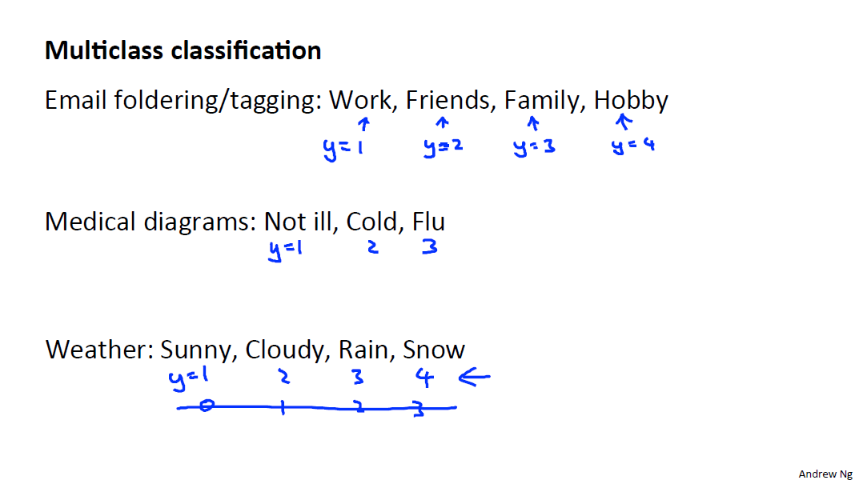

Slide 18
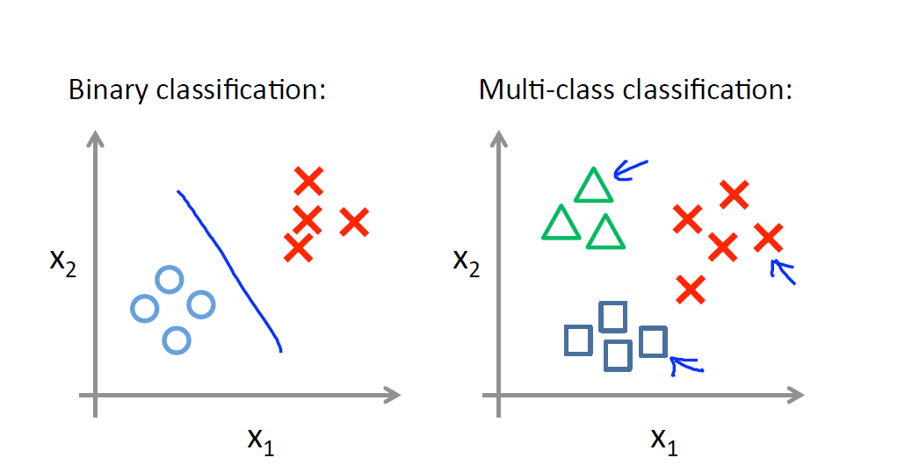

Slide 19
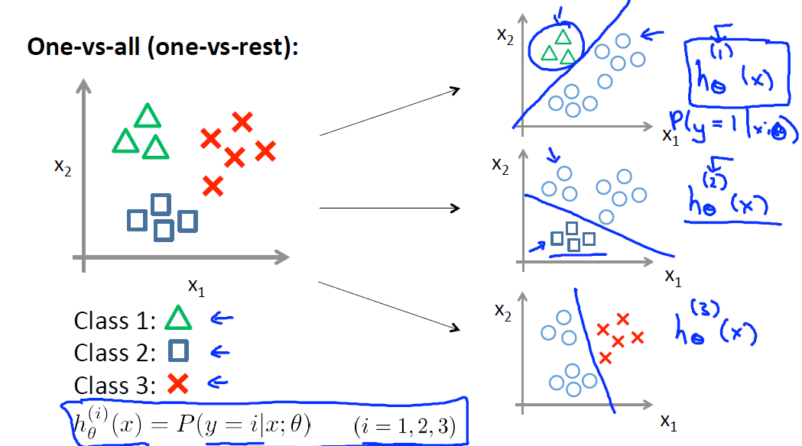

Slide 20
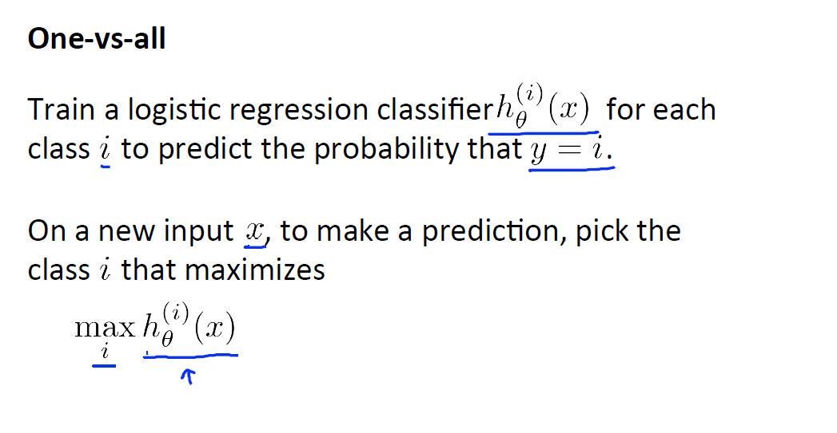

Slide 21
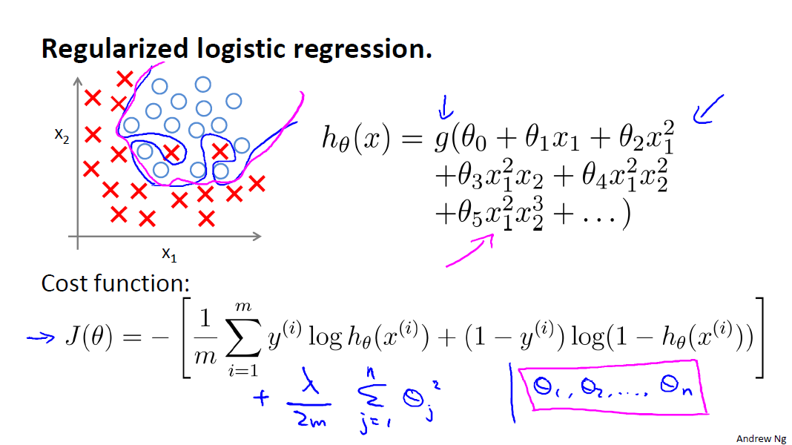

Slide 22
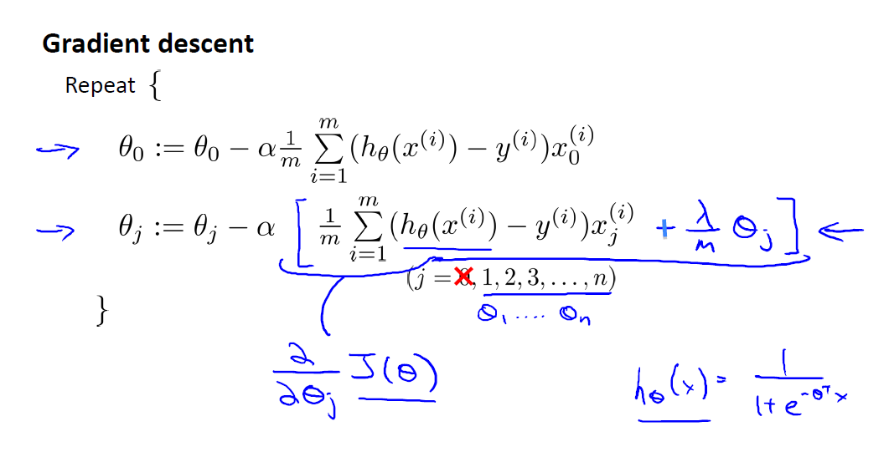

Slide 23
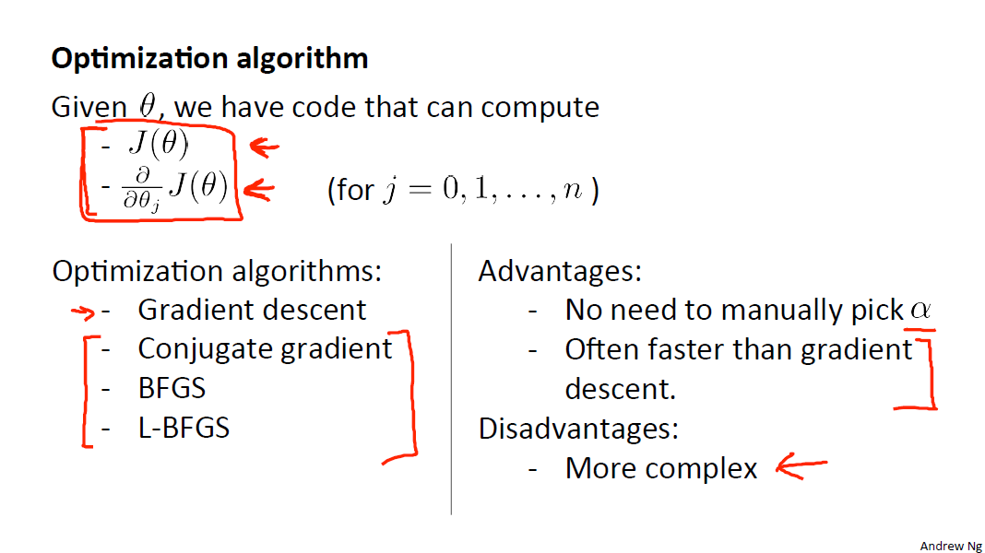

Slide 24
